Slide 1
Machine Learning Classification

Slide 2
Table of Contents
Introduction
Type of ML Models
Logistic Regression
Naïve Bayes Classifier
Data Processing
Text Data Processing
Bagging
Boosting
Support Vector Machines
Quality Metrics

Slide 3
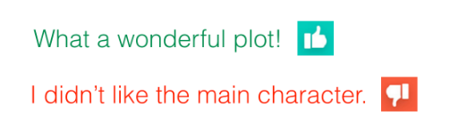
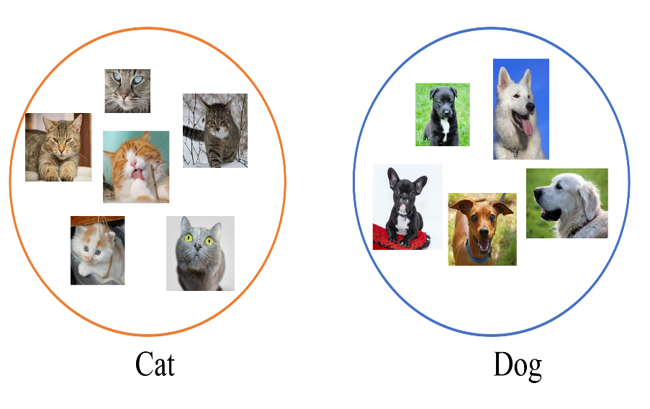
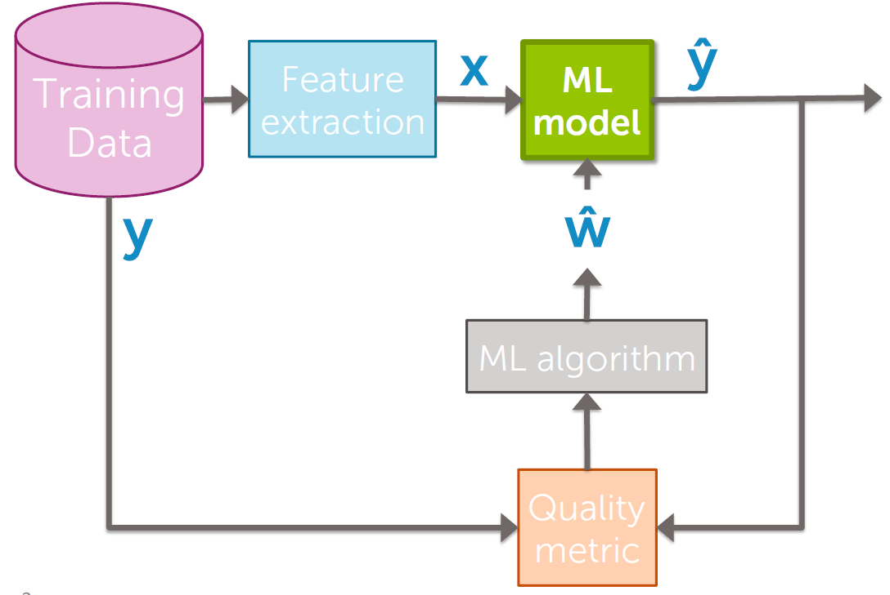
Introduction
Supervised Machine Learning Vs Unsupervised Learning
Supervised learning is where you have input variables (x) and
an output variable (Y) and you use an algorithm to learn the mapping
function from the input to the output.
Y = f(x)
The goal is to approximate the mapping function so well that
when you have new input data (x) that you can predict the output
variables (Y) for that data.
Learn from examples
ML Pipeline

Slide 4
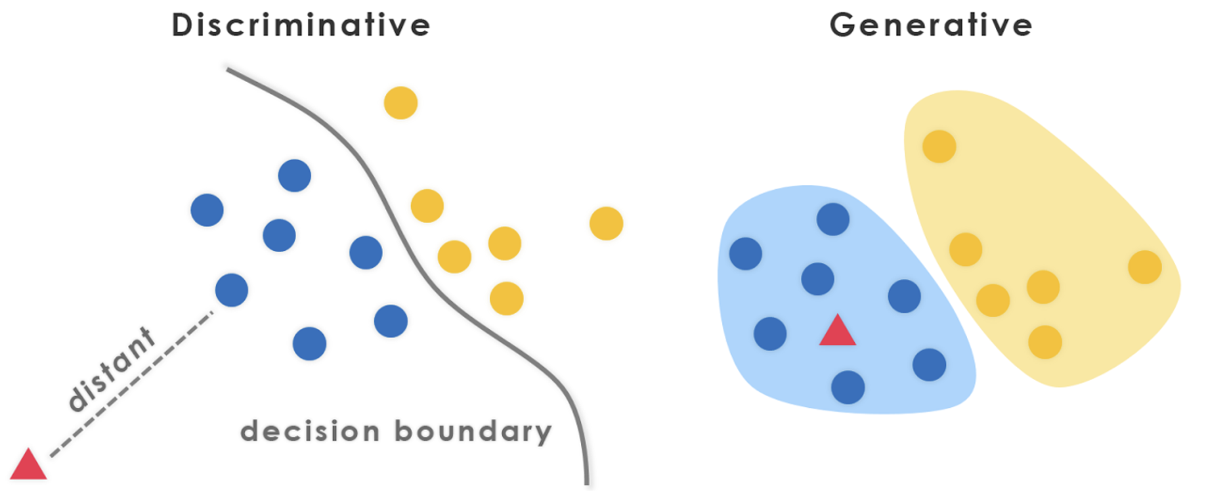
Type of ML Models
Generative and Discriminative Models
Discriminative model models the Decision Boundary between Classes
Generative Model ‌explicitly models the actual Distribution of each class
P(Y/X)
Conditional Probability
P(A|B) = [P(B|A)*P(A)]/P(B)
Probability Mass Function
Probability Density Function
Discriminative Model
Generative Model
Directly learn P(Y|X)
No Assumptions made on P(X|Y)
Eg: Logistic Regression, Neural Networks, SVM etc.
P(Y|X) = P(Y)P(X|Y)
Learn P(Y) and P(X|Y). Joint Probability, Bayes Rule
Assumes all features are conditionally independent
Eg: Bayesian Learning, Naive Bayes Classifier etc.
http://primo.ai/index.php?title=Discriminative_vs._Generative

Slide 5
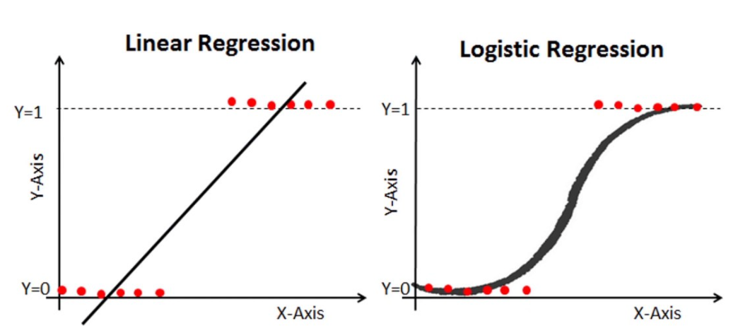
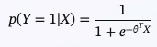
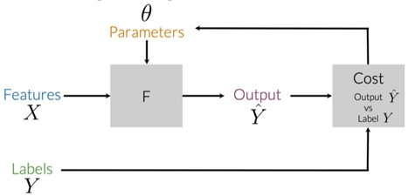
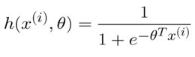
Logistic Regression
Logistic Regression is a statistical method that estimates the probability of an event based on the set of independent variables
Logistic Regression makes use of a sigmoid function which output a probability between 0 and 1
The equation for logistic regression with weights represented as Theta is:
X: Input matrix
Theta: weight vector
p(y=1|x) : Probability of the positive class
Sigmoid
Overview of Logistic Regression Pipeline

Slide 6
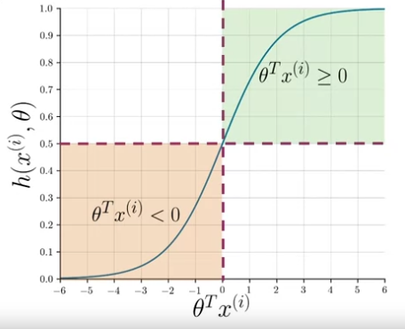
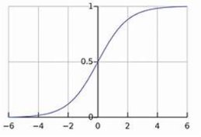
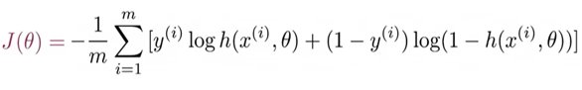
Logistic Regression
Sigmoid will take the score that ranges from (–infinity, +infinity) and squeezes it between 0 and 1
Sigmoid
Cost Function: Log Loss or Cross Entropy Loss

Slide 7
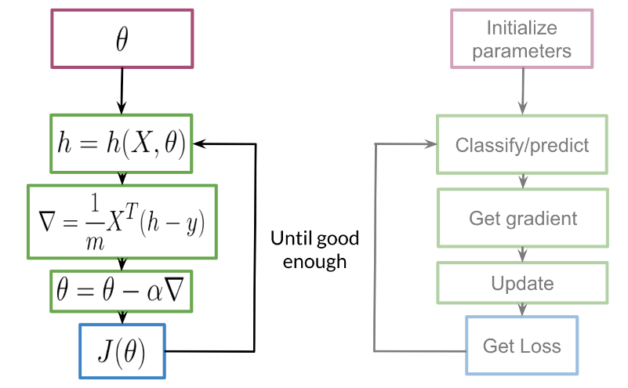
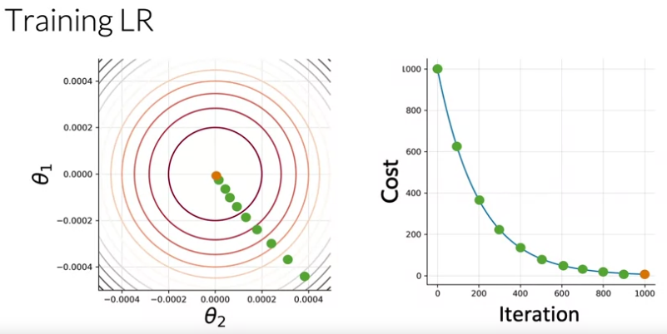
Logistic Regression
https://www.coursera.org/learn/classification-vector-spaces-in-nlp/supplement/AJSvB/logistic-regression-training

Slide 8
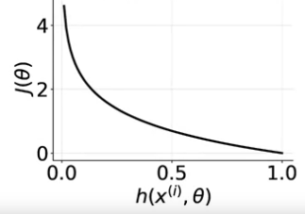
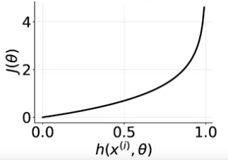
Logistic Regression : Cost Function
Y (Actual) | Y (Predicted) | Cost
0 | Any | 0
1 | 0.99 | ~0
1 | ~0 | -inf
Y (Actual) | Y (Predicted) | Cost
1 | Any | 0
0 | 0.99 | -inf
0 | 0.01 | ~0

Slide 9
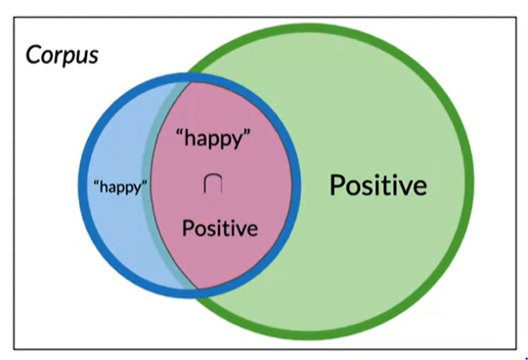
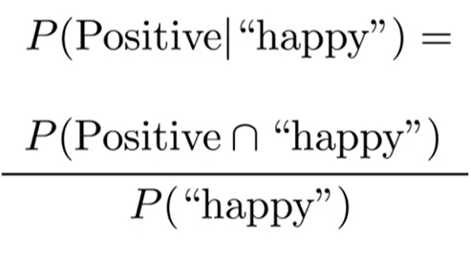
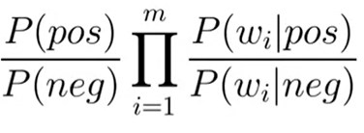
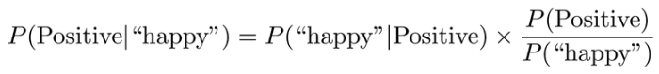
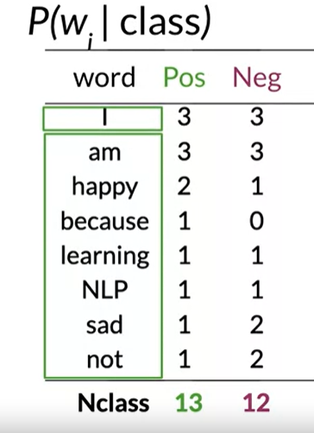
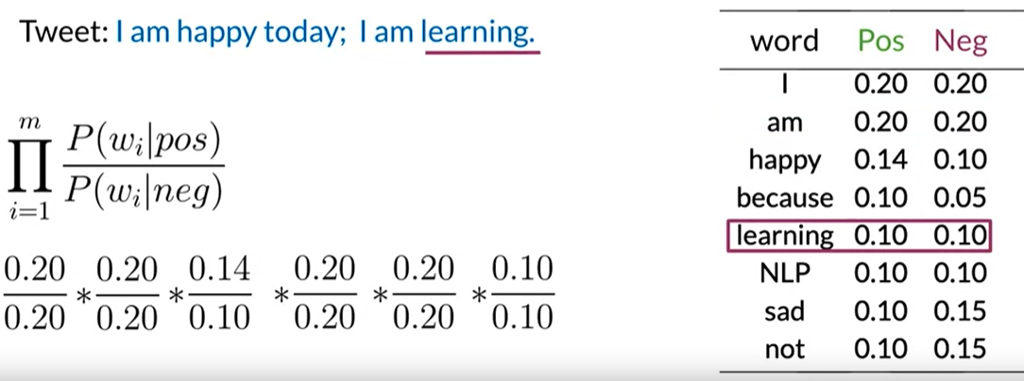
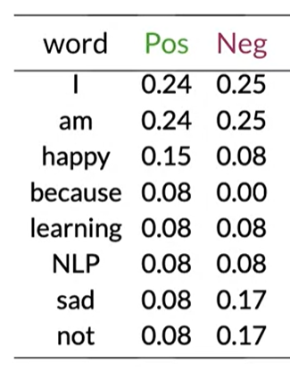
Naive Bayes Classifier (Generative Model)
Naive Bayes Assumption: Each feature is conditionally independent of every other feature given the label.
Assumption reduces the number of probabilities to learn.
Log Likelihood - Avoid numerical underflow
Bayes Rule
13
https://www.coursera.org/learn/classification-vector-spaces-in-nlp

Slide 10
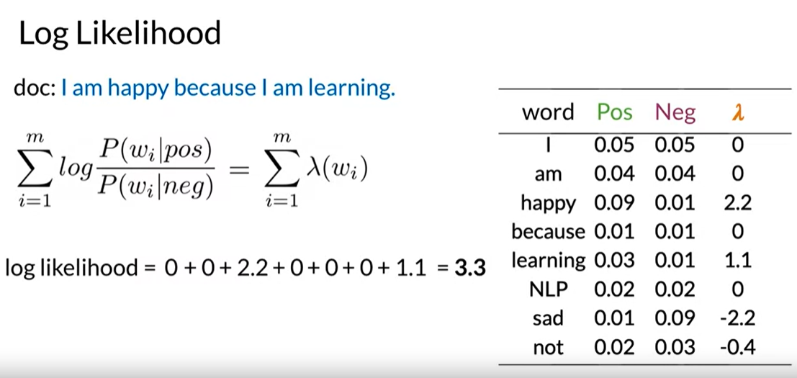
Naive Bayes Classifier - Log Likelihood
Bayes Rule
P(Y|X) = P(Y)*P(X|Y) / P(X)
Preprocess Text
Compute frequency of word in each class
Compute P(W|Pos) and P(W|Neg)
Calculate log likelihood (lambda)
Estimate log prior - Important in unbalanced datasets
13
https://www.coursera.org/learn/classification-vector-spaces-in-nlp/lecture/cIVmu/log-likelihood-part-2
https://www.deeplearning.ai/

Slide 11
Data Processing
Missing Values – Imputation (KNN)
Imbalanced Data
Under-sampling
Over-sampling
Stratified sampling
SMOTE – synthetic minority oversampling technique.
SMOTE synthesizes new minority instances between existing minority instances by generating virtual training records by linear interpolation for the minority class
Select examples that are close in the feature space, drawing a line between the examples in the feature space and drawing a new sample at a point along that line.
Dimensionality Reduction
Feature Encoding
Label Encoding

Slide 12
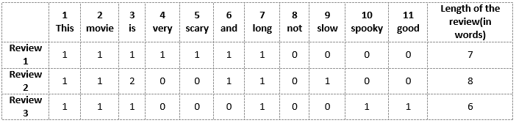
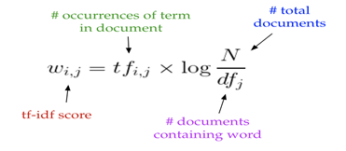
Text Data Processing
Input text needs to convertible to a format that can be
understandable by computer.
Data Cleaning → Removing punctuation, stop words, handling abbreviations etc.
Normalization → Lowercase, Stemming, Lemmatization etc.
Feature Engineering →
Bigram, Trigram
Vectorization → Bag of Words, TF-IDF etc.
Embeddings

Slide 13
Bagging | Random Forest
Bootstrap + Aggregation
Decision Tree suffers from high variance
Given a set of n observations Z1.. Zn each with variance V, variance of the mean Zmean of the observations is given by V/n. Averaging a set of observations reduces variance.
Useful for decision trees using bootstrapped training sets and averaged predictions
Individual trees are not pruned (high variance, low bias)
Out-of-Bag Error estimation
Variable importance
Random-Forest: Improvement over bagging by making decorrelated trees
M << P
Do not make any assumptions about data
Regression and Classification
Bootstrapping
Classifier 1
Classifier 2
Classifier k
Aggregation
Bagging
Ensemble Model

Slide 14
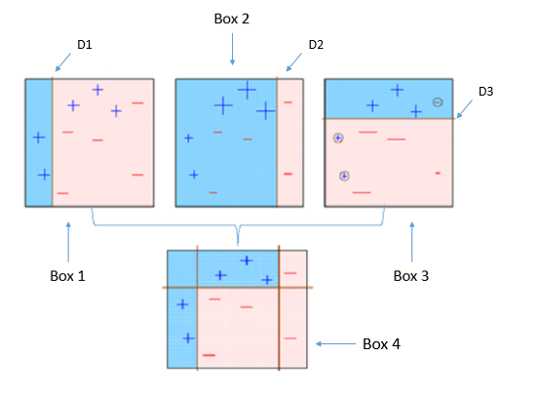
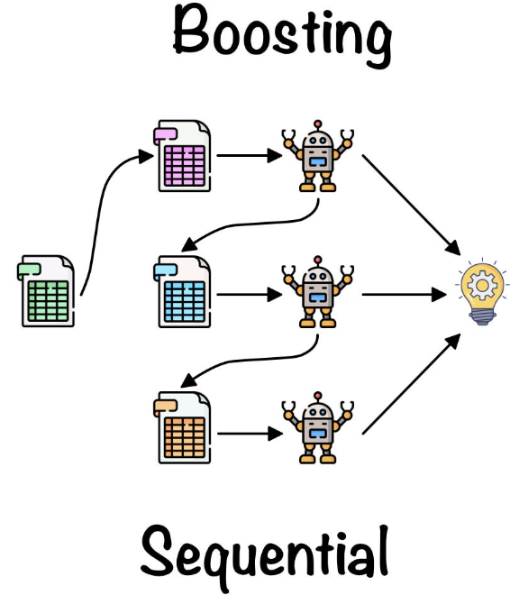
Boosting
Use weak learners to build a strong learner
A random sample of data is selected, fitted with a model and then trained sequentially—that is, each model tries to compensate for the weaknesses of its predecessor. With each iteration, the weak rules from each individual classifier are combined to form one, strong prediction rule
Can use many statistical learning methods (trees, lr etc.)
Trees are grown sequentially
No bootstrapping, each tree is fit on a modified version of the original data set

Slide 15
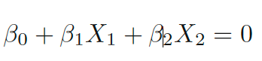
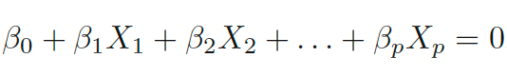
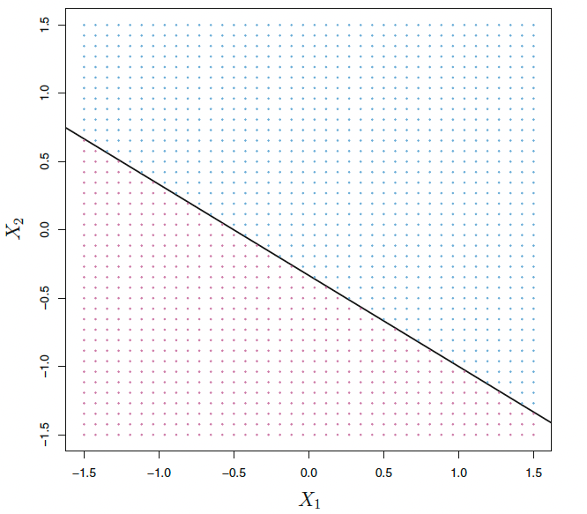
SVM – Maximal Marginal Classifier
Generalization of Maximum Marginal Classifier.
Separating hyperplane
Hyperplane
In two dimensions, a hyperplane is defined by the equation. In two dimension, it is a line –
In p-dimension :
If a point X = (X1, X2, .. Xp) satisfies above equation, X lies on the hyperplane. If X does not satisfy (>0 or <0), X lies to one side of the hyperplane. Hyperplane is dividing p-dimensional space into two halves.
The hyperplane 1 + 2X1 + 3X2 = 0 is shown. The blue region is
the set of points for which 1+2X1 +3X2 > 0, and the purple region is the set of points for which 1 + 2X1 +3X2 < 0.

Slide 16
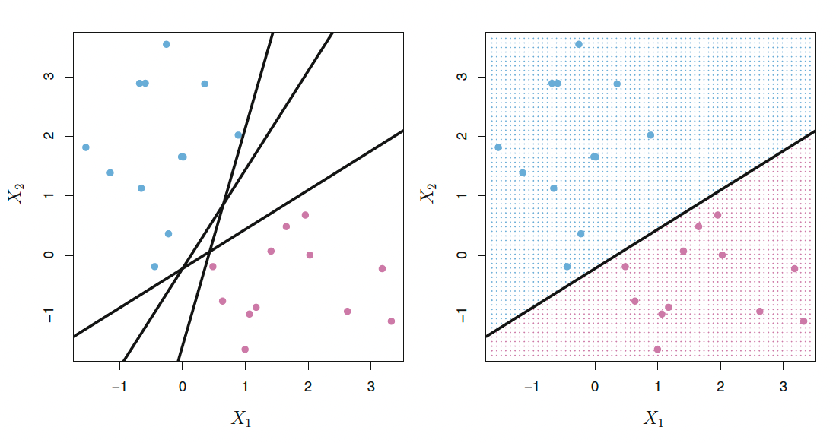
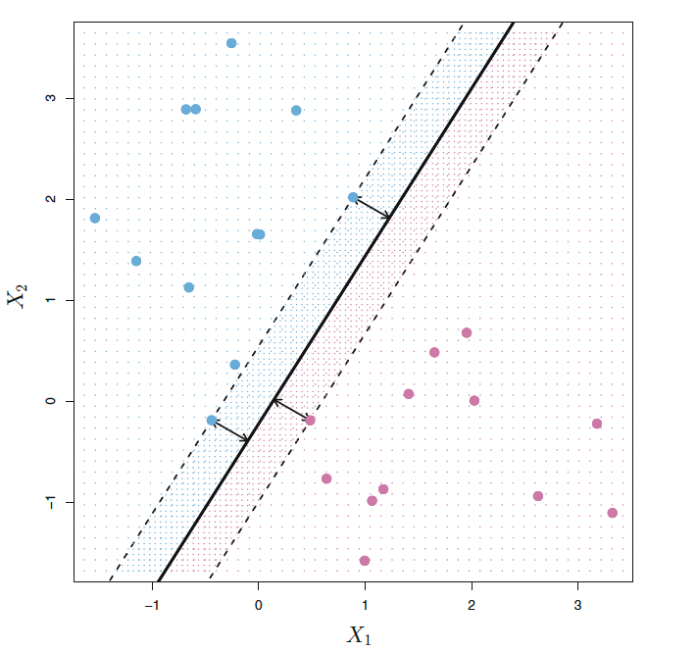
SVM – Maximal Marginal Classifier
Maximal marginal classifier – separating hyperplane that is farthest from each training observations
Support Vectors indicates the width of the margin. Maximal margin hyperplane depends directly on the support vectors, but not on the other observations.
Maximal marginal classifier does not work if there is no clear separating boundary between classes.

Slide 17
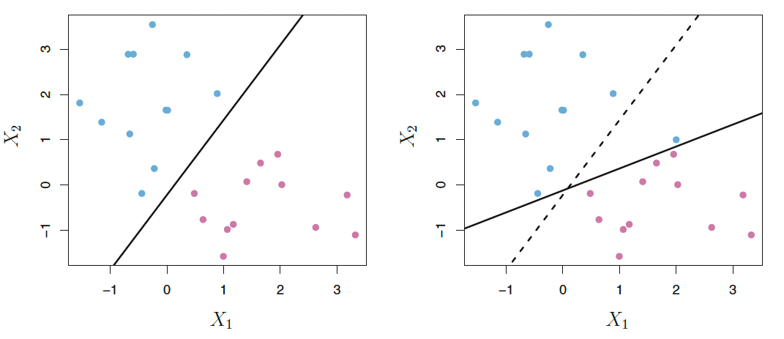
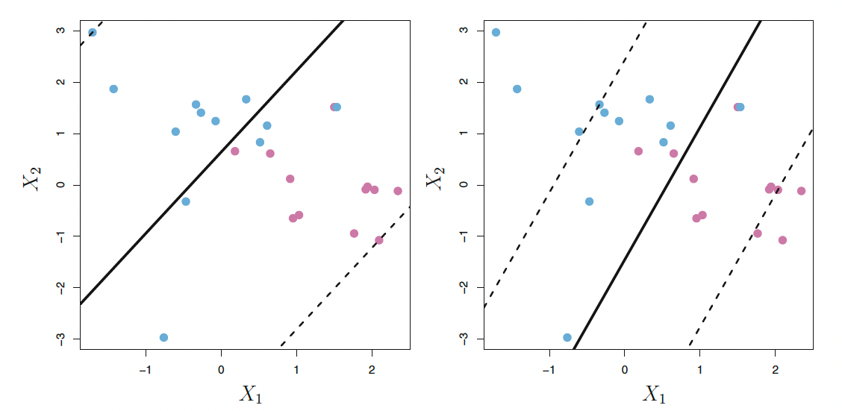
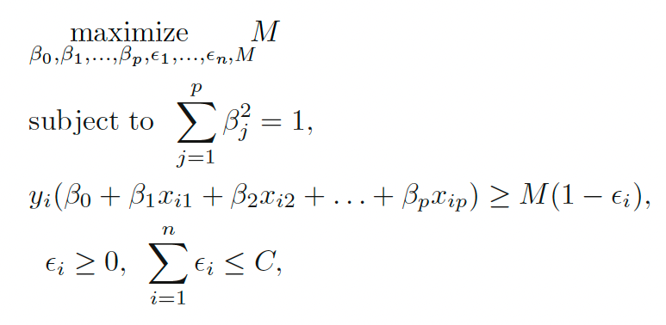
SVM – Support Vector Classifier
Addition of a single blue point dramatically shift the margin.
Worthwhile to misclassify a few training observations in order to do a better job in classifying the remaining observations.
Soft margin classifier
* C is a nonnegative tuning parameter.
* M is the width of Margin.
* Slack variables
Different C value and Margin

Slide 18
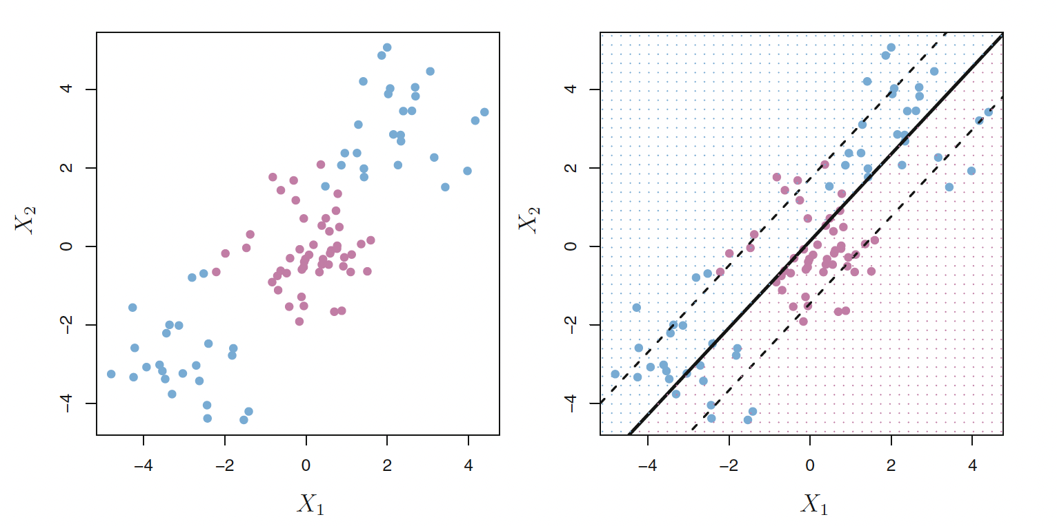
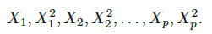
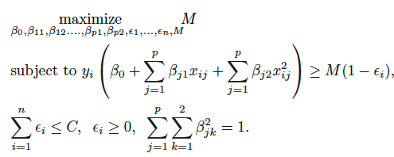
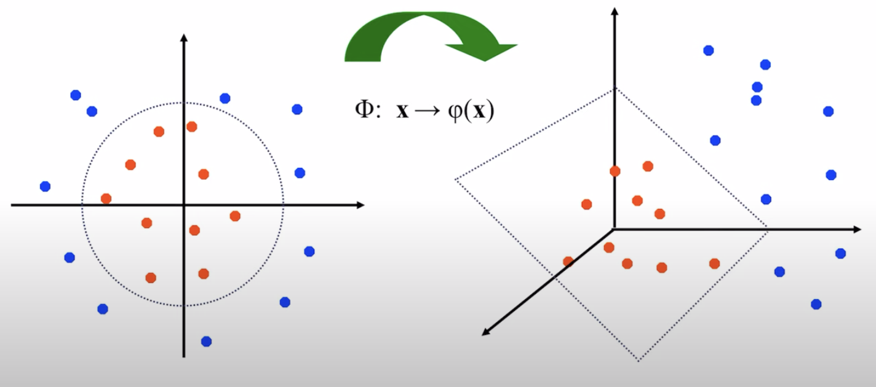
Support Vector Machines
Enlarge the feature space by using quadratic, cubic or higher order polynomial functions of the predictors.
For example, instead of fitting a support vector classifier for p features, X1, X2, ..Xp, We could fit using 2p features.
SVC with linear boundary performs bad here
Support Vector Machine is an extension of SVC that results from enlarging the feature space using Kernels. Idea is to project the data into higher dimension space and separate them using linear boundaries.

Slide 19
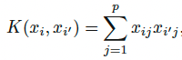
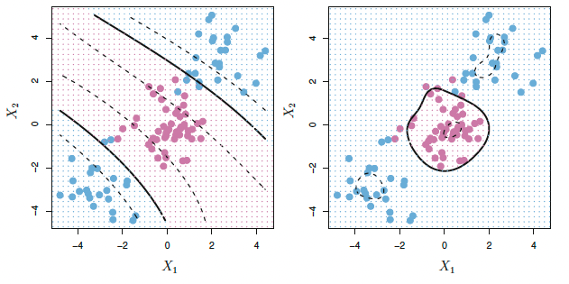
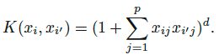
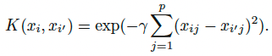
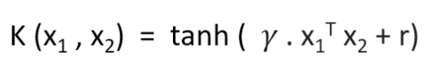
SVM - Kernels
Linear Kernel
Polynomial Kernel
Radial Kernel
Sigmoid Kernel
Left: SVM with Polynomial Kernel with degree 3, Right: SVM with Radial Kernel

Slide 20
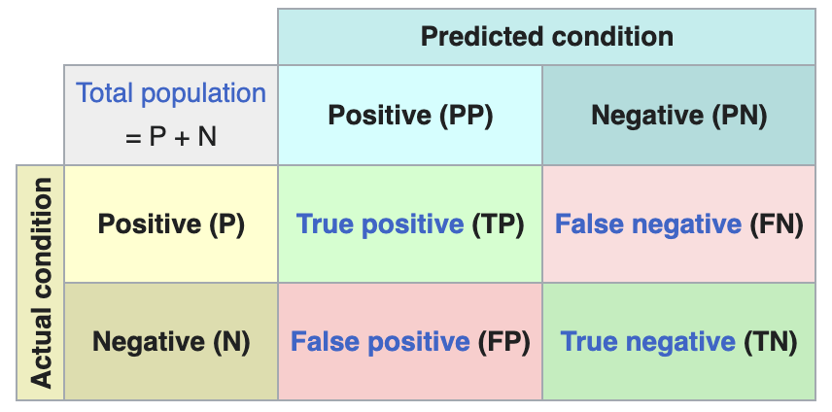
Quality Metrics
Accuracy: No of correct predictions / All predictions. Why accuracy is not always good?
Precision: How many were positive out of those predicted positive →
True Positives/(True Positives +False Positives)
Recall: True Positive / (True Positives + False Negatives)
F1 Score: (2* Precision * Recall) / (Precision + Recall)
ROC: The ROC (Receiver Operating Characteristic) curve is a probability curve that plots the true positive rate (TPR) against the false positive rate (FPR) at various threshold values . The area under the ROC curve (AUC) represents the degree of separability or the ability of a classifier to distinguish between classes . Higher the AUC, better the model is at predicting 0s as 0s and 1s as 1s
Quality metrics for multiclass classification?
Confusion Matrix

